Slide 1

CSC 1004: Tutorial 8
Introduction of Snake Game and
Python Tkinter
Guanren Qiao
SDS, CUHK-SZ

Slide 2
Basic Function
The player's goal is to control a snake to eat as much food as possible, causing the snake to grow longer.
Control its direction to find food at a fixed speed with Keyboard.
Food items randomly appear on the game board.
The game ends under the following conditions: The snake collides with the boundaries of the game area. The snake collides with its own body, essentially running into itself.
Utilizes the tkinter library to create a graphical user interface.

Slide 3
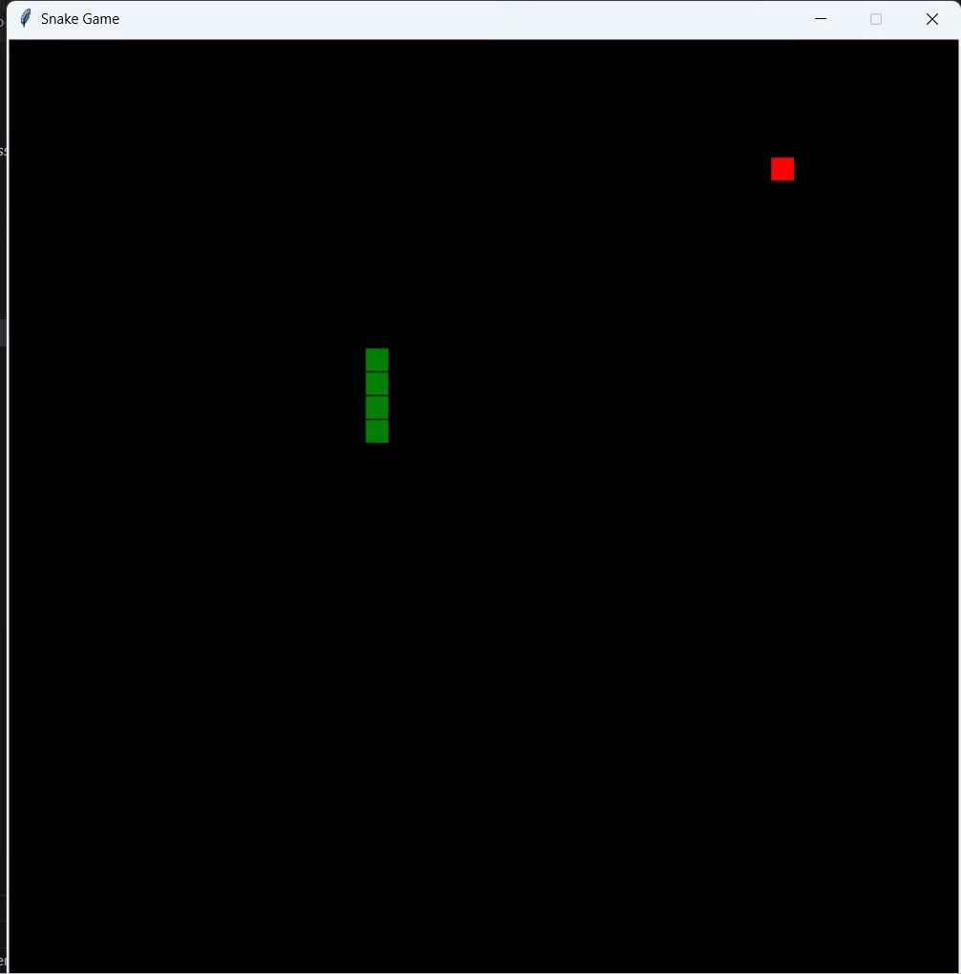
Advanced Function
Different Effects of Food (10%)
Adding Obstacles (5%)
Adding score function (5%)
Multi-Level Challenges (15%)
Dynamic velocity (10%)
Adding start menu (5%)
More exploration ...

Slide 4
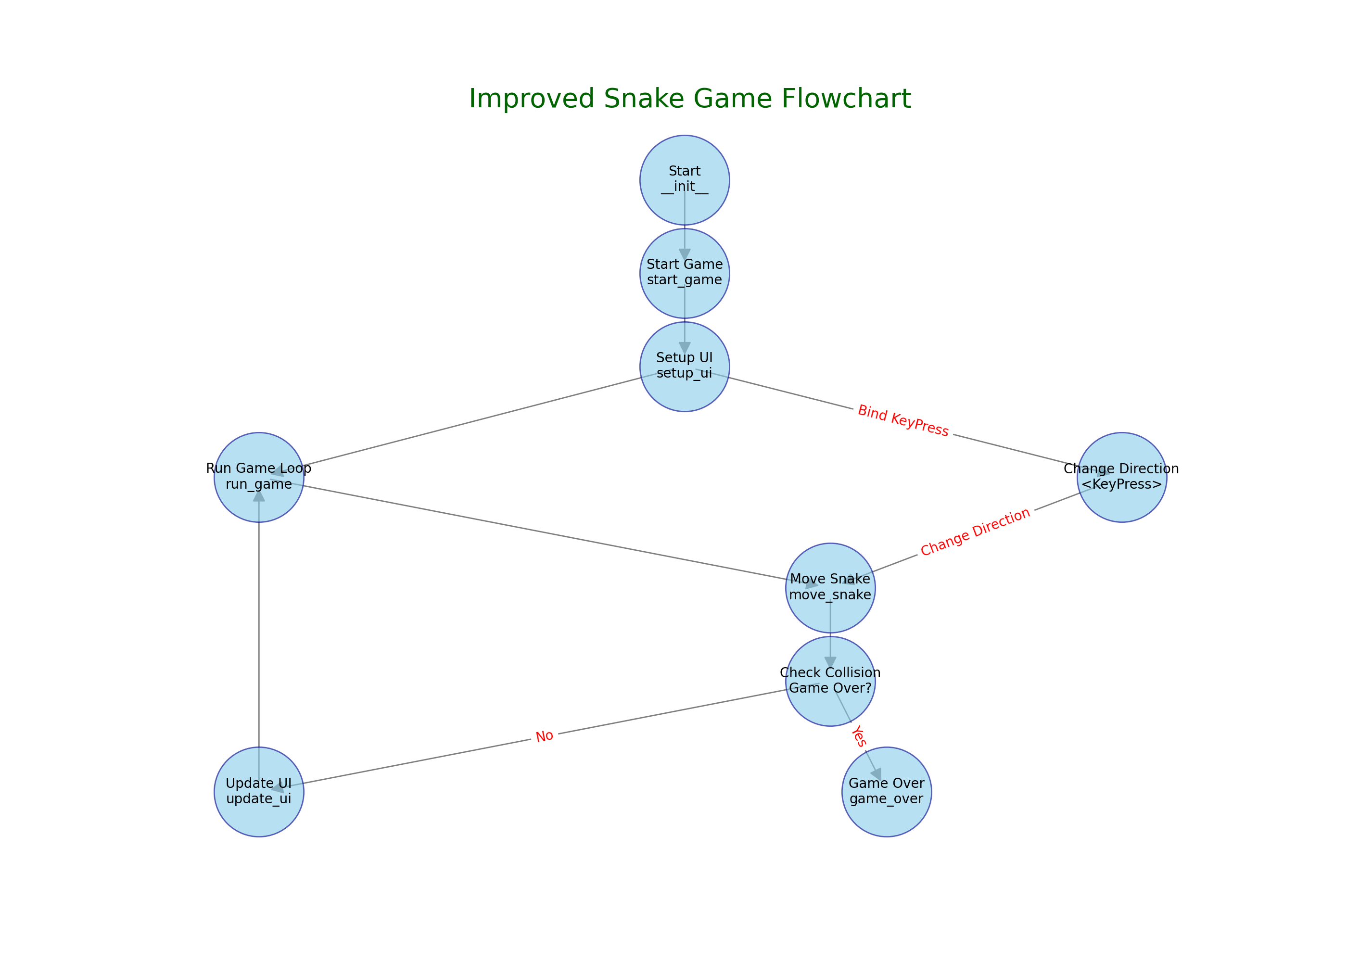
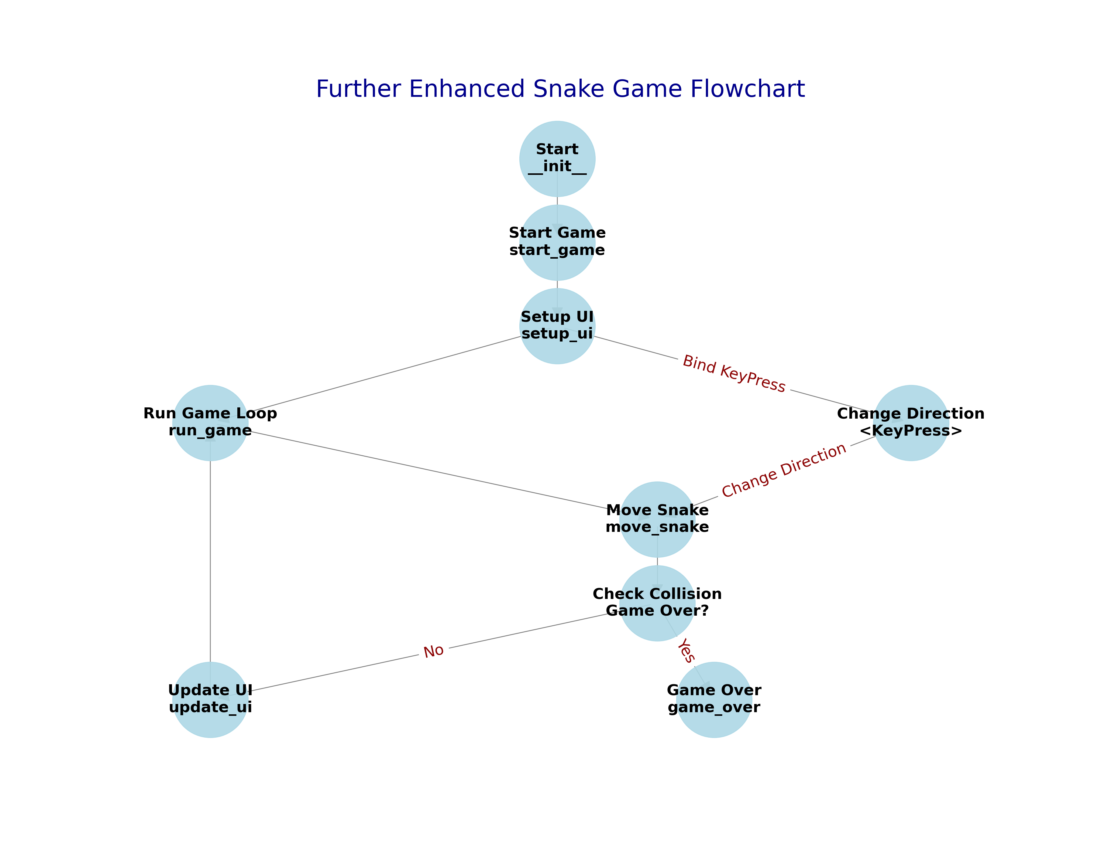
project
logic
chain

Slide 5
def create_food(self):
while True:
x = random.randint(0, (self.width//self.cell_size)-1) * self.cell_size
y = random.randint(0, (self.height//self.cell_size)-1) * self.cell_size
food = (x, y)
if food not in self.snake:
return food
project code framework
def move_snake(self):
if self.snake_direction == 'Left':
...
if new_head == self.food:
...
self.food = self.create_food()
if (new_head[0] < 0 or new_head[0] >= self.width or
new_head[1] < 0 or new_head[1] >= self.height or
new_head in self.snake[1:]):
self.game_over()
...
self.update_ui()
if __name__ == "__main__":
game = SnakeGame()
game.mainloop()
def game_over(self):
self.canvas.create_text(self.width//2, self.height//2, text="Game Over", fill="white", font=('TkDefaultFont', 24))
self.unbind("<KeyPress>")
def update_ui(self):
self.canvas.delete('all')
...
self.canvas.create_rectangle()
class SnakeGame(tk.Tk):
def __init__(self):
super().__init__()
self.title("Snake Game")
self.geometry("800x800")
self.resizable(False, False)
...
self.start_game()
def run_game(self):
self.move_snake()
self.after(100, self.run_game)
def change_direction(self, event):
...
self.snake_direction = event.keysym
def start_game(self):
...
self.setup_ui()
self.run_game()
def setup_ui(self):
self.update_ui()
self.bind("<KeyPress>", self.change_direction)

Slide 6
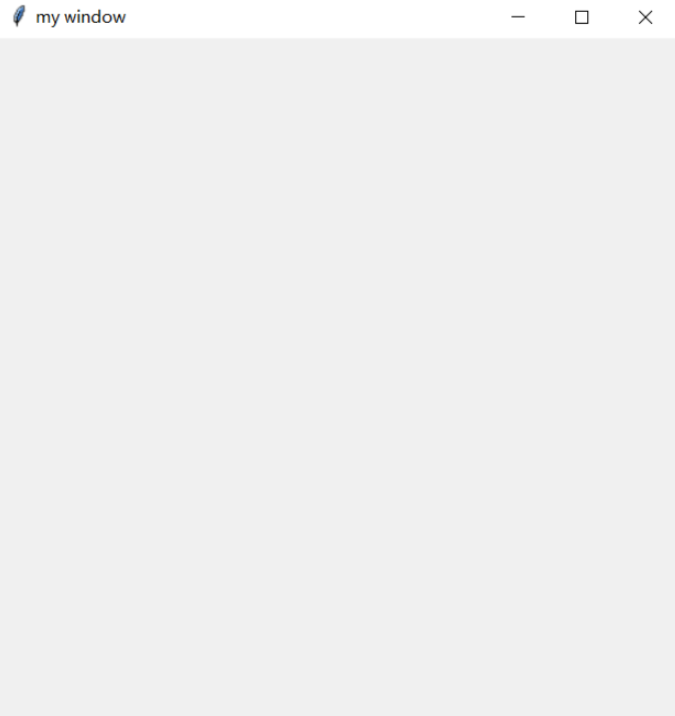
Tkinter mainloop
if you want to create a Tkinter GUI
import tkinter
window = tkinter.Tk()
window.title('my window')
window.geometry('500x500')
window.mainloop()

Slide 7
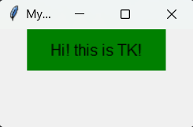
Tkinter Label (1)
import tkinter as tk
window=tk.Tk()
window.title('Mywindow')
window.geometry('200x100')
l = tk.Label(window,
text='Hi! this is TK!',
bg='green',
font=('Arial', 12),
width=15,
height=2
)
l.pack()
window.mainloop()

Slide 8
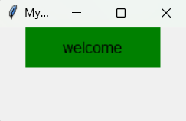
Tkinter Label (2)
import tkinter as tk
window=tk.Tk()
window.title('Mywindow')
window.geometry('200x100')
var=tk.StringVar()
var.set(‘welcome’)
l = tk.Label(window,
textvariable=var,
bg='green',
font=('Arial', 12),
width=15, height=2)
l.pack()
window.mainloop()

Slide 9
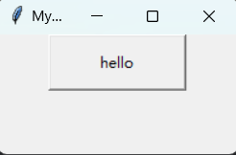
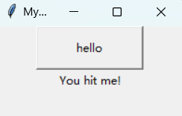
Tkinter Button
import tkinter as tk
window=tk.Tk()
window.title('Mywindow')
window.geometry('200x100')
on_hit=False
var = tk.StringVar()
def hit_me():
global on_hit
if on_hit==False:
on_hit=True
var.set('You hit me!')
else:
on_hit=False
var.set('')
b=tk.Button(window,text='hello',width=15,height=2,command=hit_me)
b.pack()
label = tk.Label(window, textvariable=var)
label.pack()
window.mainloop()

Slide 10
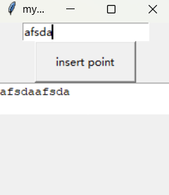
Tkinter Entry & Text
import tkinter as tk
window = tk.Tk()
window.title('my window')
window.geometry('200x200')
e=tk.Entry(window,show=None)
e.pack()
def insert_point():
var=e.get()
t.insert('insert',var)
b = tk.Button(window,text="insert point",width=15,
height=2,command=insert_point)
b.pack()
t=tk.Text(window,height=2)
t.pack()
window.mainloop()

Slide 11
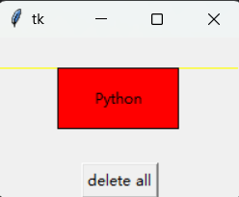
Tkinter Canvas
import tkinter as tk
root = tk.Tk()
w = tk.Canvas(root, width =200, height = 100)
w.pack()
line1 = w.create_line(0, 50, 200, 50, fill = "yellow")
line2 = w.create_line(100, 0, 100, 100, fill = "red", dash = (4, 4))
rect1 = w.create_rectangle(50, 25, 150, 75, fill = "blue")
w.coords(line1, 0, 25, 200, 25)
w.itemconfig(rect1, fill = "red")
w.delete(line2)
w.create_text(100, 50, text = "Python")
tk.Button(root, text = "delete all", command = (lambda x = "all" : w.delete(x))).pack()
root.mainloop()

Slide 12
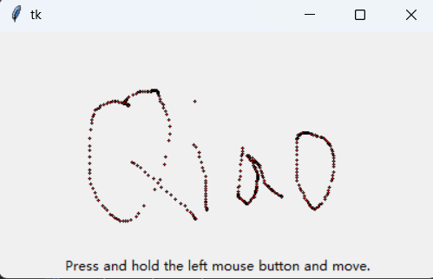
Tkinter Canvas
import tkinter as tk
root = tk.Tk()
w = tk.Canvas(root, width = 400, height = 200)
w.pack()
def paint(event):
x1, y1 = (event.x - 1), (event.y - 1)
x2, y2 = (event.x + 1), (event.y + 1)
w.create_oval(x1, y1, x2, y2, fill = "red")
w.bind("<B1-Motion>", paint)
tk.Label(root, text = "Press and hold the left mouse button and move.").pack(side = "bottom")
root.mainloop()

Slide 13
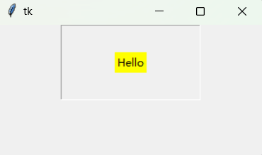
Tkinter Frame
from tkinter import *
root=Tk()
root.geometry('300x150+888+444')
fr1=Frame(root,relief='groove',bd=1,padx=60,pady=30)
fr1.pack()
la1=Label(fr1,text='Hello',bg='yellow')
la1.pack()
root.mainloop()

Slide 14
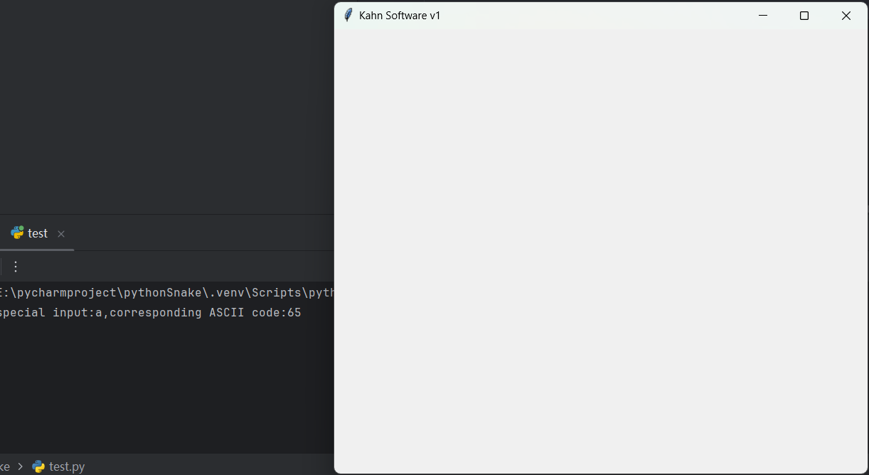
Tkinter key_event
import tkinter
def xFunc1(event):
print(f"special input:{event.char},corresponding ASCII code:{event.keycode}")
win = tkinter.Tk()
win.title("Kahn Software v1")
win.geometry("600x500+200+20")
win.bind("a", xFunc1)
win.mainloop()

Slide 15
Python Class (1)
class people:
#define basic(public) attribute
name = ''
age = 0
#define private attribute
__weight = 0
#initialization
def __init__(self,n,a,w):
self.name = n
self.age = a
self.__weight = w
def speak(self):
print("%s say: I %d years old。" %(self.name,self.age))
# Instantiate a class
p = people('runoob',10,30)
p.speak()

Slide 16
Python Class (2) Inheritance
class people:
name = ''
age = 0
__weight = 0
def __init__(self,n,a,w):
self.name = n
self.age = a
self.__weight = w
def speak(self):
print("%s 说: 我 %d 岁。" %(self.name,self.age))
class student(people):
grade = ''
def __init__(self,n,a,w,g):
people.__init__(self,n,a,w)
self.grade = g
def speak(self):
print("%s say: I’m %d years old，and my grade is %d"%(self.name,self.age,self.grade))
s = student('ken',10,60,3)
s.speak()

Slide 17
THE END
THANKS

